Slide 1
Hypertext Transport Protocol (HTTP)
Mendel Rosenblum
CS142 Lecture Notes - HTTP

Slide 2









Web Application Architecture
Web Server /
Application server
Storage System
Web Browser
HTTP
LAN
Internet
2

Slide 3
http://www.example.com:80/index.html
Universal Resource Locator (URL)
To display page browser fetches the file index.html from a web server
Same as www.example.com (Defaults: port 80, file index.html, http protocol)
HTTP (HyperText Transport Protocol)
HTTP - Simple request-response protocol layered on TCP/IP
  Establish a TCP/IP connection to www.example.com:80
  Send a http GET request along connection
  Read from the connection the response from the web server
CS142 Lecture Notes - HTTP

Slide 4
Send HTTP Request - Write lines to socket
Method URL
Protocol Version
GET /index.html HTTP/1.1 Host: www.example.com User-Agent: Mozilla/5.0 Accept: text/html, */* Accept-Language: en-us
Accept-Charset: ISO-8859-1,utf-8 Connection: keep-alive
blank line
Header
Body (optional)
CS142 Lecture Notes - HTTP

Slide 5
HTTP Methods (Verbs)
GET - Fetch a URL
HEAD - Fetch information about a URL
PUT - Store to an URL
POST - Send form data to a URL and get a response back
DELETE - Delete a URL
GET and POST (forms) are commonly used. REST APIs used GET, PUT, POST, and DELETE
CS142 Lecture Notes - HTTP

Slide 6
HTTP Response - Read lines from socket
Version Status
Status Message
HTTP/1.1 200 OK
Date: Thu, 24 Jul 2008 17:36:27 GMT
Server: Apache-Coyote/1.1
Content-Type: text/html;charset=UTF-8 Content-Length: 1846
blank line
<?xml ... >
<!DOCTYPE html ... >
<html ... >
...
Header
Body
</html>
CS142 Lecture Notes - HTTP

Slide 7
Common HTTP Response Status Codes
200 OK
307 Temporary Redirect
404 Not Found
503 Service Unavailable 500 Internal Server Error 501 Not Implemented
Bad Request
Unauthorized
403 Forbidden
550 Permission denied
Success
Redirection - Browser retries using Location header Famous one
Something crashed on the server Something is messed up on the server Coming
Use if web app sends bogus request Use if user isn't logged in
Use if even logging in wouldn't help Not allow to perform request
CS142 Lecture Notes - HTTP

Slide 8
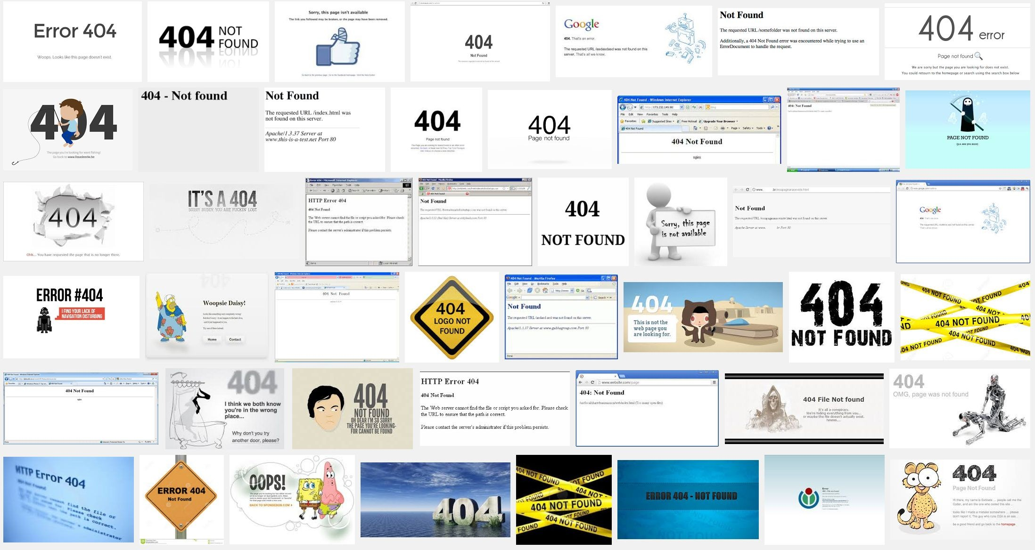
CS142 Lecture Notes - HTTP

Slide 9
Browser caching control
HTTP Response Header: Cache-Control: max-age=<Seconds>
Browser can reuse reply younger than the max-age
Cache-Control: max-age=120 - Age out in two minutes.
Frequently used on fetches of static content like images, templates, CSS, JavaScript.
Good: Reduce app startup latency and server load Bad: Changes might not be picked up right away
Consider Web App changes?
CS142 Lecture Notes - HTTP

Slide 10
Browser spends its life fetching things using HTTP
Some fetched immediately
<link href="angular-material.css" rel="stylesheet" />
<script src="angular.js" type="text/javascript" ></script> window.location = "http://www.example.com";
Some asynchronous and in parallel
<img src="smiley.gif">
<img src="foobar.jpg">
<img src="foobar2.jpg">
Some can be in background
<a href="http://www.example.com"></a>
CS142 Lecture Notes - HTTP

Slide 11
What would this JavaScript do?
elm.innerHTML =
"<script src="http://www.example.com/myJS.js" type="text/javascript" ></script>"
Uses HTTP to fetch myJS.js and runs it! Scary but useful.
CS142 Lecture Notes - HTTP

